Slide 1



D5.2.5 Virtual Cluster on Federated Cloud Demonstration Kit
August 2012
Version 1.0
Copyright © 2012 CESGA. All rights reserved.
The research leading to these results has received funding from the European Community's Seventh Framework Programme (FP7/2007-2013) under grant agreement n° 257386.

Slide 2
Overview
Objective:
To show the BonFIRE programming capabilities for developing Experiment Agents using as an example a Virtual Cluster developed by VCOC experiment.
Audience:
Cloud experimenters, programmers, and researchers who would like to know more about how to develop Experiment Agents for BonFIRE

Slide 3
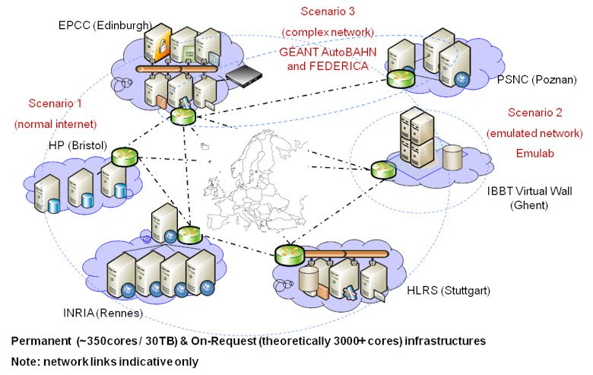
BonFIRE Infrastructure
MultiSite Cloud
More information:
http://www.bonfire-project.eu/infrastructure
Source: http://www.bonfire-project.eu/infrastructure (August 2012)

Slide 4
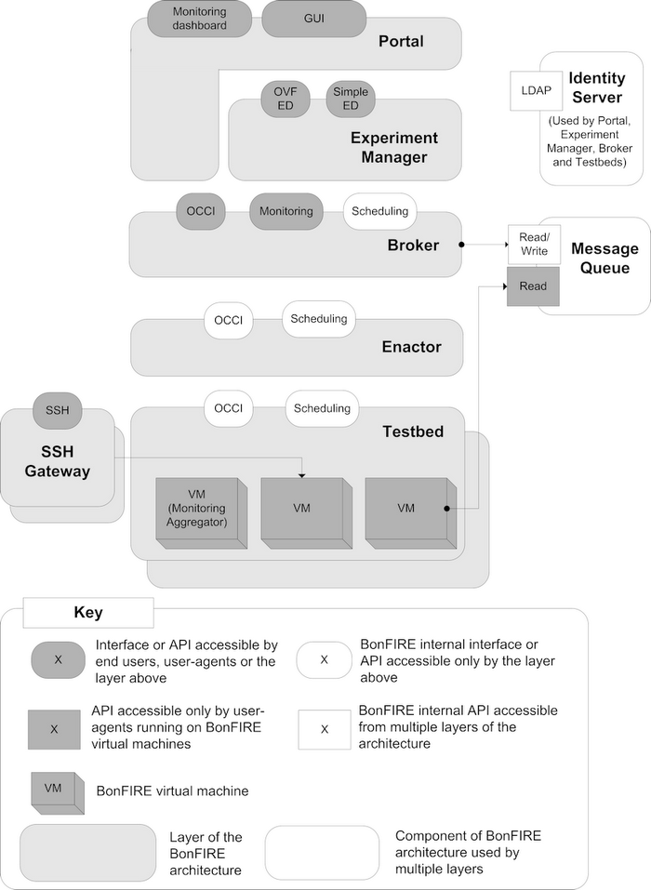
BonFIRE Architecture
VCOC Experiment Agent uses this interface
Appliance and storage are created using Resource Manager (Broker)
To login to VMs, the SSH gateway is used
Source: http://www.bonfire-project.eu/infrastructure/bonfire-architecture

Slide 5
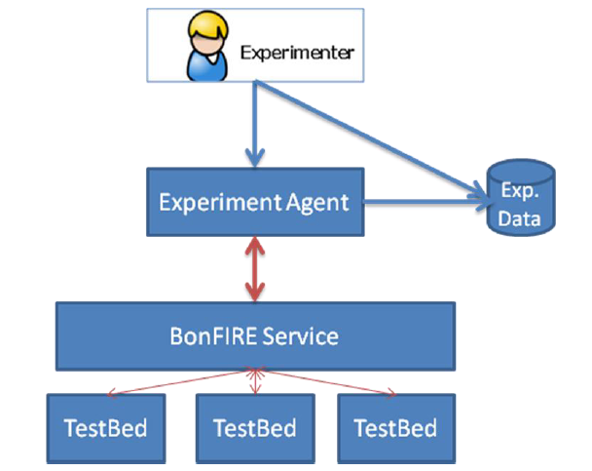
VCOC Experiment Agent
Manages multiple experiment executions
Works with the Experiment Manager
Controls deployed resources
Stores Experiment data

Slide 6
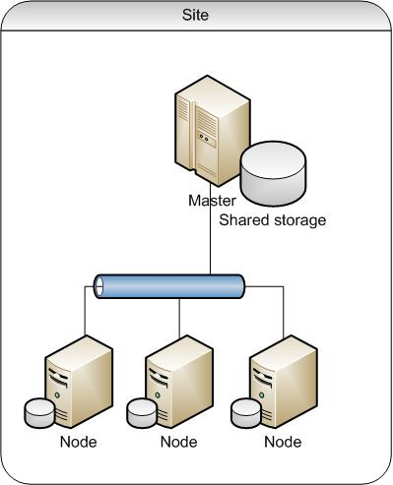
Virtual Cluster Architecture
Manages Open Grid Scheduler
Shares filesystem using NFS
Controls setup and executions
Executes Jobs
Open Grid Scheduler Compute Element

Slide 7
Demonstration Steps
1. Create your own appliance:
Master, client, and additional disk storage resources will be created and configured contacting with BonFIRE Resource Manager using Ruby script based on BonFIRE restfully.
2. Create your experiment descriptor:
A Virtual Cluster Experiment Descriptor will be created that uses these private appliances. It utilizes curl + BonFIRE API to check that these storage resources are available.
3. Execute the experiment:
The Experiment Descriptor will be executed. The Experiment Agent will control the deployment of the experiment and the status of the Virtual Cluster, recording times for each step. Once the experiment is deployed, it is automatically deleted.

Slide 8
Before you start
You must have:
  A BonFIRE account (request it from http://portal.bonfire-project.eu)
You need:
  LINUX machine, and
  openSSH
  curl
  python 2.7 with modules httplib2, multiprocessing, etree, and libxml2
  ruby (version 1.8.7)
  restfully (see install instructions from BonFIRE at http://doc.bonfire-project.eu)
  subversion
Or download the Demo Kit Appliance:
  From: https://upload.cesga.es/?vid=67f214a3-95e3-8f68-827e-00003b0134c1
  OVA format.
  Import it into your VM manager. It has been tested only on VirtualBox
  Password bonfire2012

Slide 9
Before Start: Download Demo Kit
Using Subversion:
  If your own LINUX, execute (password is anonsvn):
svn checkout –username anonsvn http://cvs.forge.cesga.es/svn/bonfiredemokit
  In the distributed appliance, upgrade to last version
svn update –username anonsvn

Slide 10
Before Start: Security setup
Configure SSH:
  Generate a key using ssh-keygen command
  Upload public key to your BonFIRE portal user details.
  Configure SSH Gateway parameters to access deployed VM (they will use private BonFIRE WAN network without public IPs).
  Templates at bonfiredemokit/security/ssh
  Steps
  Go to directory ~/.ssh
  Execute (DO NOT SET PASSWORD FOR KEY)
  ssh-keygen –t rsa
  Copy bonfiredemokit/security/ssh/config
  Edit config file and substitute [login@] by yourUsername@
  Copy public key and upload it to your BonFIRE portal user details

Slide 11
Before Start: Restfully setup
Configure restfully:
  Add your user and password to .restfully/api.bonfire-project.eu.yml
  Templates at bonfiredemokit/security/restfully
  Steps
  Create directory ~/.restfully
  Copy bonfiredemokit/security/restfully/api.bonfire-project.eu.yml
  Protect it with chmod 700 api.bonfire-project.eu.yml
  Edit it to add your BonFIRE username and password

Slide 12
Step 1. Generate your Master private appliance
Create Master VM appliance:
  Restfully-script using BonFIRE Resource Manager: build-master.rb
  The script creates an experiment
  It starts a BonFIRE-provided VM appliance
  Remotely installs needed software
  Uploads OGS software (it will be deployed on startup)
  Uploads VCOC control scripts
  Saves new machine as VirtualClusterMaster-<your username>-v0.1
  Steps
  Go to directory bonfiredemokit/virt-cluster
  Execute:
  restfully –c ~/.restfully/api.bonfire-project.eu.yml build-master.rb

Slide 13
Step 1. Generate your Client private appliance
Create Client VM appliance:
  Restfully-script using BonFIRE Resource Manager: build-client.rb
  It creates an experiment
  Starts a BonFIRE-provided VM appliance
  Remotely installs needed software
  Saves new machine as VirtualClusterClient-<your username>-v0.1
  Steps
  Go to directory bonfiredemokit/virt-cluster
  Execute:
  restfully –c ~/.restfully/api.bonfire-project.eu.yml build-client.rb

Slide 14
Step 1. Generate your additional storage
Create Additional Storage for Master:
  Restfully-script using BonFIRE Resource Manager: build-storages.rb
  It creates an experiment
  Creates a new private permanent storage resource
    <your username>_volume-1GB-empty
  Starts a BonFIRE-provided VM appliance and attaches the new storage resource
  Initialises it to 0’s
  Saves it and changes its persistent property to FALSE.
  Steps
  Go to directory bonfiredemokit/virt-cluster
  Execute:
  restfully –c ~/.restfully/api.bonfire-project.eu.yml build-storages.rb

Slide 15
Step 2. Create an Experiment Descriptor
Create JSON Experiment Description:
  Bash script: create_vcoc.sh
  It checks that needed appliances and storage resources are available using curl + BonFIRE API interface
  Creates a Virtual Cluster JSON descriptor on ../examples
  Virtual Cluster is composed of one master machine with additional storage resource plus one computing element.
  Steps
  Go to directory bonfiredemokit/virt-cluster
  Execute:
  bash create_vcoc.sh –n 1

Slide 16
Step 2. Looking to Experiment Descriptor
{
"name": "Virtual Cluster Demo Experiment",
"description": "Demo Virtual Cluster",
"duration": 180,
"resources": [
{
"compute": {
"name": "master",
"description": "Virtual Cluster Master",
"instanceType": "small",
"locations": ["fr-inria"],
"resources": [
{ "storage": "@VirtualClusterMaster-vcocdemo-v0.1"},
{ "storage": "@vcocdemo_volume-1GB-empty"},
{ "network": "@BonFIRE WAN"}
],
"contexts": [
{
}
]
}
},
{
"compute": {
"name": "client-1",
"description": "Virtual Cluster Client",
"instanceType": "small",
"locations": ["fr-inria"],
"resources": [
{ "storage": "@VirtualClusterClient-vcocdemo-v0.1"},
{ "network": "@BonFIRE WAN"}
],
"contexts": [
{
}
]
}
}
]
}
Name of the Managed Experiment
Description of the experiment
Maximum elapsed time for the Experiment in minutes
Location for deployment
Main Storage Resource
Master Virtual Machine Configuration
Additional Storage Resource
Network
Client Virtual Machine Description

Slide 17
Step 3. Execute the Experiment
Execute the Managed Experiment with Experiment Agent:
  Python program
  It deploys Experiment using BonFIRE Experiment Manager
  Checks status of the deployment
  Checks VMs are ready
  Checks OGS is running
  Records time measurements
  Deletes experiment
  Saves data
  Steps
  Go to directory bonfiredemokit/ea
  Execute:
  python submit_file.py vcoc.json

Slide 18

END
  CONGRATULATIOS!!!!
  You have executed your first experiment!!!
  Now, explore the scripts to create your own
  Demo Kit Provided by

Slide 19
Thank you for your attention

